Slide 1
SESSION:12
Inputs/Outputs Programming
Microprogrammed Control
Control Memory
Address Sequencing
Microprogram Example
Design Control Unit

Slide 2
Input-Output Programming
When we write programs we use the symbols that are defined by programming language. The symbols in a language are strings of characters and each character is assigned an 8-bit code in order to store it in computer memory. A binary-coded character enters the computer when an INP (input) instruction is executed. A binary-coded character is transferred to the output device when an OUT (output) instruction is executed. The output device detects the binary code and types the corresponding character.

Slide 3
Programs to Input and Output One Character

Slide 4
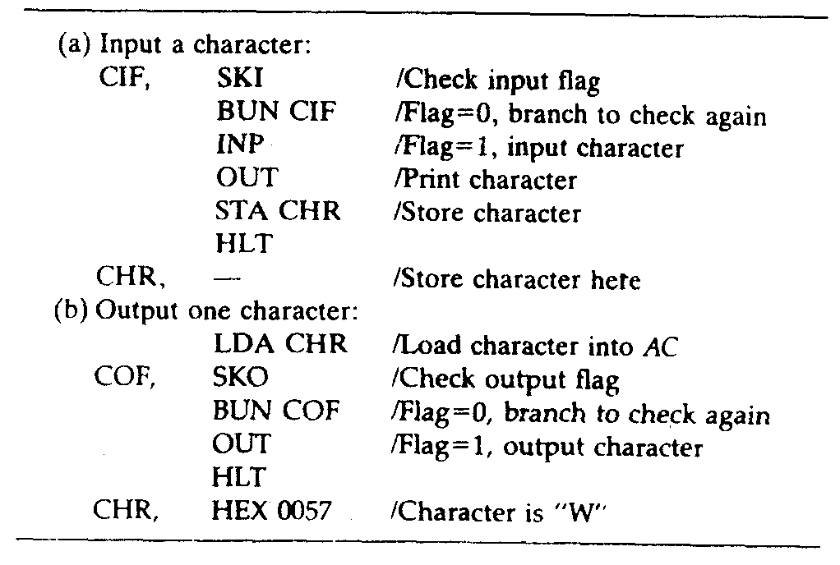

Slide 5
Control Memory
A memory that is part of a control unit is called a control memory.
A computer that uses a microprogrammed control unit usually has two separate memories - a main memory and a control memory. The main memory is available to the user for storing their programs. The contents of main memory may change when the data are manipulated and every time the program is changed.

Slide 6
Address Sequencing
When power is turned on in the computer, an initial address is loaded into the control address register. This address is the address of the first microinstruction that activates the instruction fetch routine. The fetch routine may be sequenced by incrementing the control address register through the rest of its microinstructions. At the end of the fetch routine, the instruction is in the instruction register of the computer.

Slide 7
Conditional Branching
. The status conditions are special bits that give parameter information, for example, the carry out of an adder, the sign bit of a number, the mode bits of an instruction, and input or output status conditions. Information in these bits can be tested and actions initiated based on their condition whether their value is 1 or 0. The status bits, together with the field in the microinstruction
that specifies a branch address, control the conditional branch decisions generated in the branch logic.

Slide 8
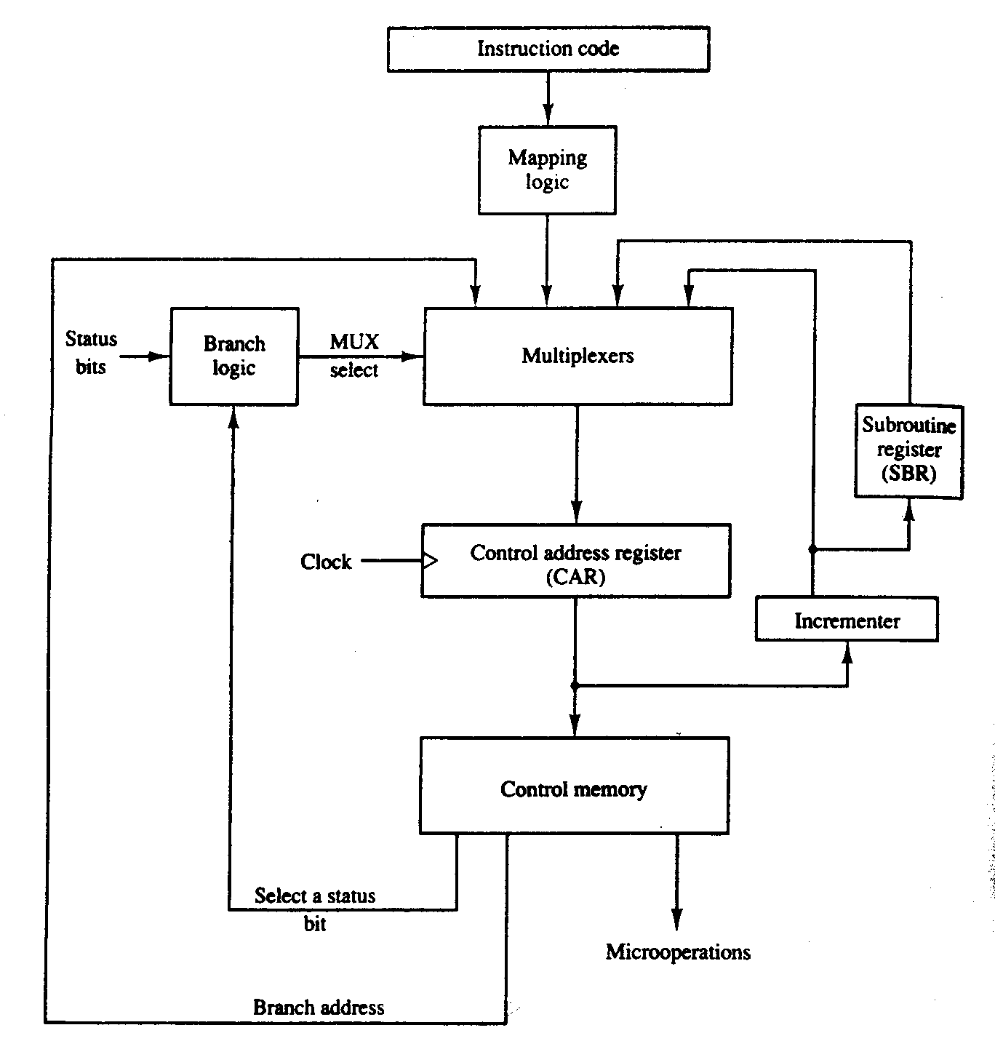

Slide 9
Mapping of Instruction
The status bits for this type of branch are the bits in the operation code part of the instruction.

Slide 10
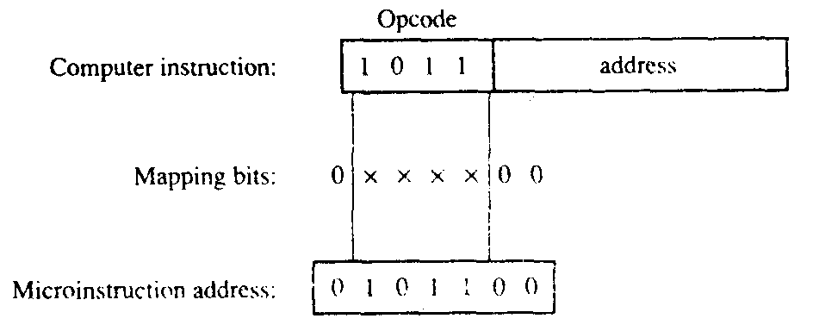

Slide 11
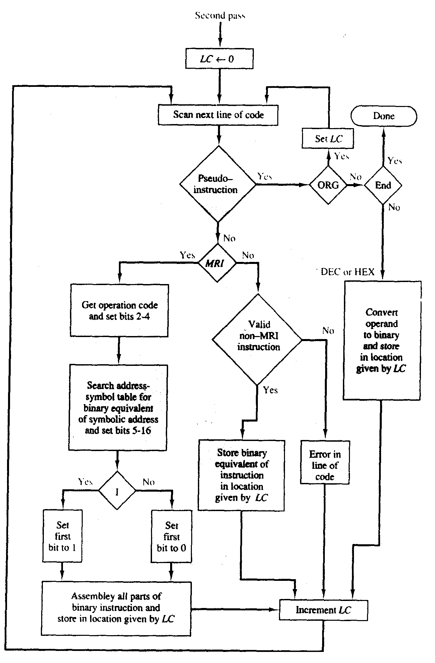

Slide 12
Unit 5
Central Processing Unit

